Slide 1

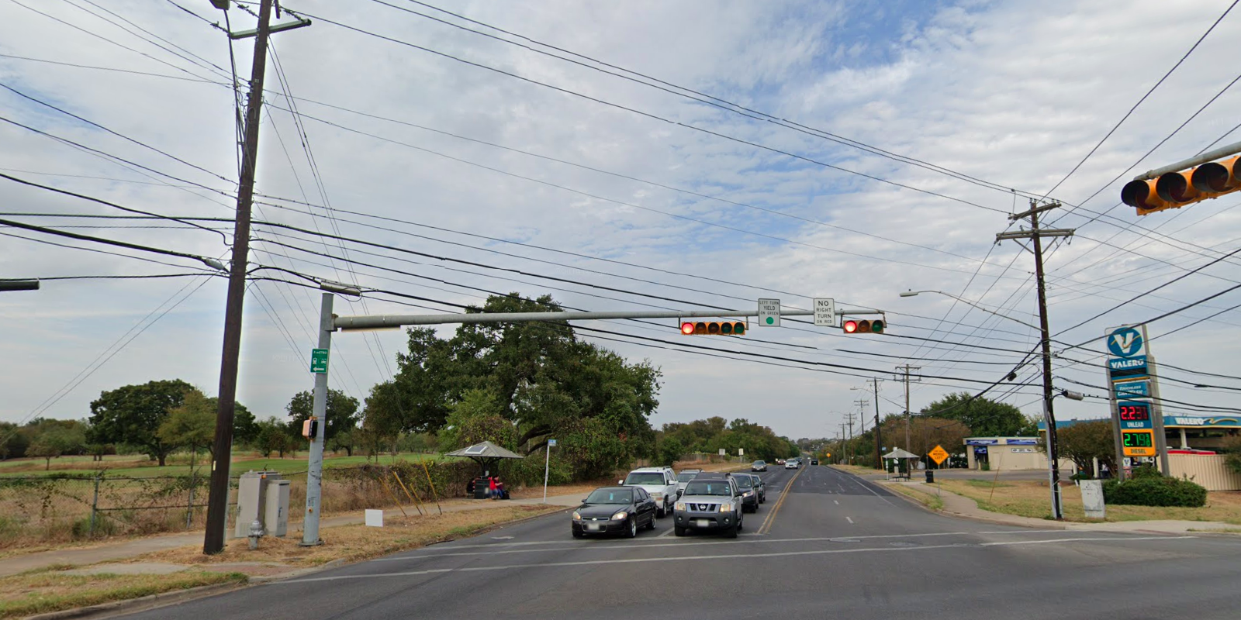
Austin Transportation Department Signs Work Orders
Created By: Susanne Gov Created Date: 2020-08-10 Location Name: MARTIN LUTHER KING JR BLVD / SPRINGDALE RD Intersection ID: 5164054 Cardinal Direction: N Work Order ID: SG-20637
Sign Type | Install/Remove
Left Turn Yield On Green | Install
No Right Turn On Red | Install
Metro | Install

Slide 2
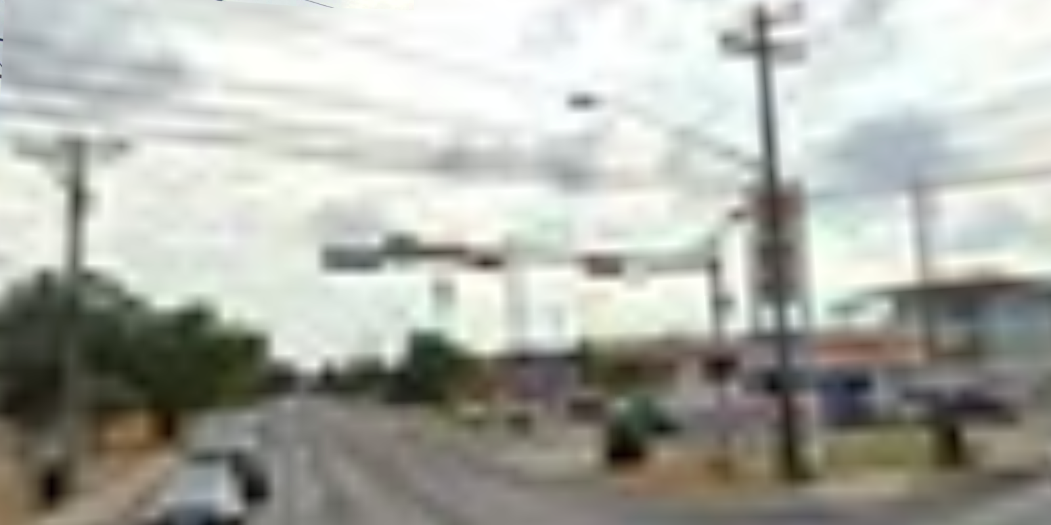
Austin Transportation Department Signs Work Orders
Created By: Susanne Gov Created Date: 2020-08-10 Location Name: MARTIN LUTHER KING JR BLVD / SPRINGDALE RD Intersection ID: 5164054 Cardinal Direction: S Work Order ID: SG-20637
Sign Type | Install/Remove
Left Turn Yield Flashing Yellow | Remove

Slide 3
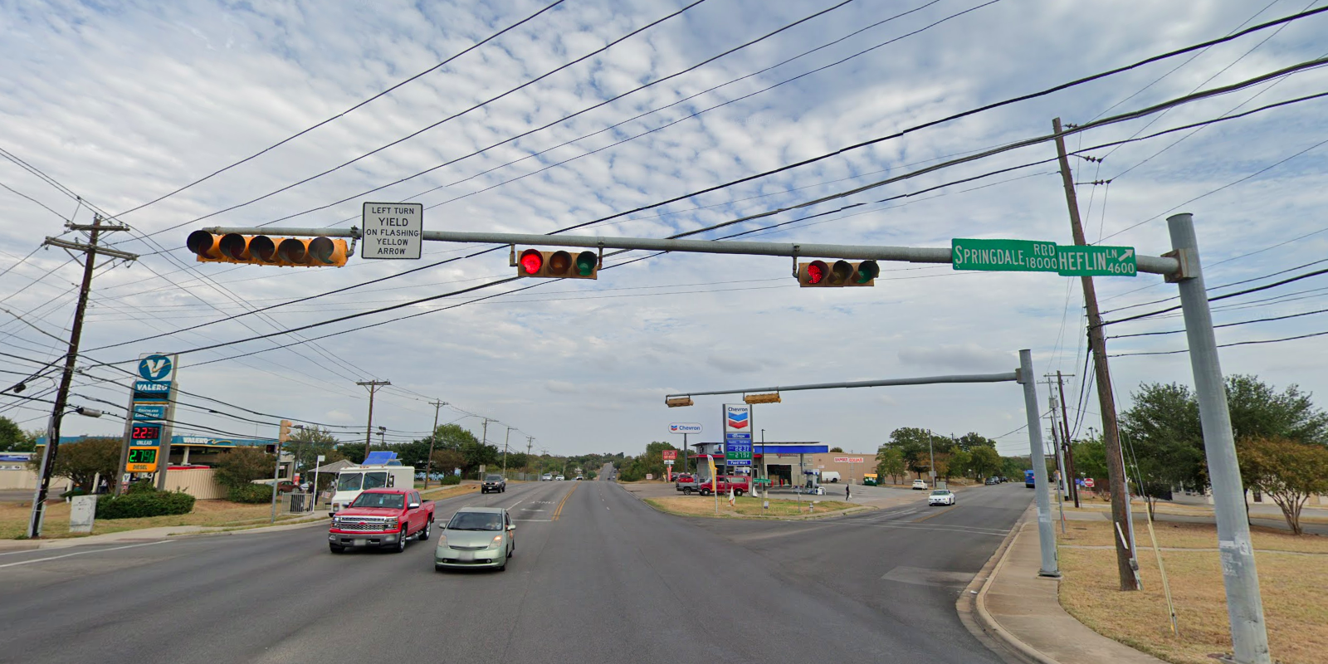
Austin Transportation Department Signs Work Orders
Created By: Susanne Gov Created Date: 2020-08-10 Location Name: MARTIN LUTHER KING JR BLVD / SPRINGDALE RD Intersection ID: 5164054 Cardinal Direction: E Work Order ID: SG-20637
Sign Type | Install/Remove
Left Turn Yield Flashing Yellow | Remove
Street Name Sign | Install

Slide 4
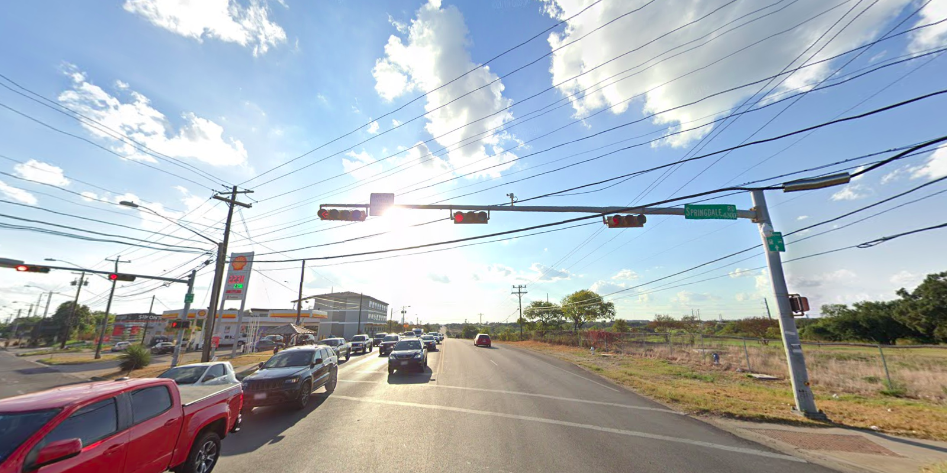
Austin Transportation Department Signs Work Orders
Created By: Susanne Gov Created Date: 2020-08-10 Location Name: MARTIN LUTHER KING JR BLVD / SPRINGDALE RD Intersection ID: 5164054 Cardinal Direction: W Work Order ID: SG-20637
Sign Type | Install/Remove
Street Name Sign | Install
Metro | Install
Left Turn Yield Flashing Yellow | Remove

